Slide 1
Presentation – The American Revolution Event
By
Student Name

Slide 2
Introduction
In every society, there comes events that define certain decades.
It is always very vital for people to understand the arcs and significances of such events.
This presentation focuses on a decade-defining event in the history of the Americans and the entire world in general – THE AMERICAN REVOLUTION.
Welcome!

Slide 3
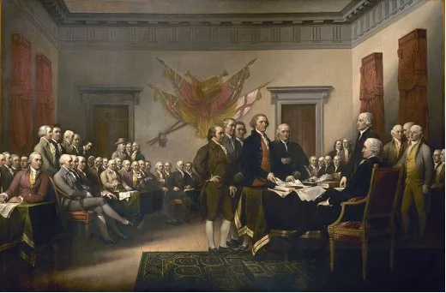
The American Revolution
The American Revolution took place between 1775-1783.
The shockwaves of this event are felt up to this day.
It signaled the inception of American Independence.
The revolution took ideas from early Greece and Rome civilizations.
These ideas were combined with the Christian Bible to revolt against an unbending authority.
Notes:
The American Revolutionary War arose from growing tensions between residents of Great Britain’s 13 North American colonies and the colonial government, which represented the British Myths of the American Revolution History Smithsonian The American Revolution entailed some remarkable transformations--converting British colonists into American revolutionaries, and a cluster of colonies into a . 1778 - 1781. Treaty of Paris, 1783.

Slide 4
Causes; founding of colonies
French and Indian War
It was another cause of the Revolutionary War
It lasted 1754 to 1763 (Graf, 2010).
Was a fight between American colonies and the new France.
Both sides had Native American tribes’ alliances.
British troops allied with the colonists to help them fight but were stationed in the colonies for protection afterwards.
The troops were paid for and Britain needed money to pay for them.
The British parliament thought it wise to tax the American colonies in order to pay for the troops.
Of the American colonies, majority had escaped religious persecution from England.
As the British government got more involved in the affairs of colonies, people started worrying that they’d lose their freedom.

Slide 5
Taxes, Laws, and More Taxes
In 1764, the British government began to impose new laws and taxes (Graf, 2010).
Examples of them included the Sugar Act, Currency Act, Quartering Act, and the Stamp Act.
Colonists never liked the move - the new taxes.
The colonists declined to pay since they had no reps in the British parliament.
They came up with the slogan "No Taxation Without Representation.“
These were likely termed as unnecessary policy impositions

Slide 6
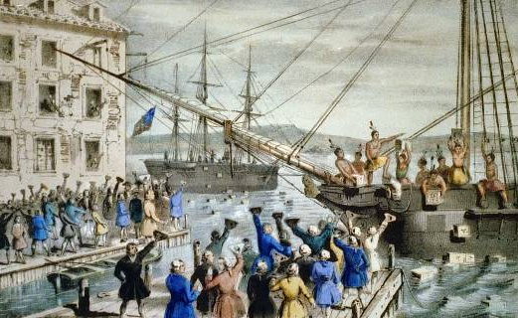
Boston Protests
Many colonists protested against these new British taxes and laws.
Sons of Liberty formed in 1765 in Boston and spread in other colonies (American Revolution for kids).
Protests emerged in Boston and several colonists were shot and killed – the Boston Massacre.
In 1773, the British imposed a new tax on tea.
Several patriots in Boston protested this act by boarding ships in Boston harbor and dumping their tea into the water.

Slide 7
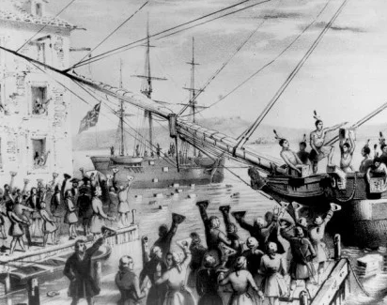
The American revolution in detail
This event brought the ideology of equality
“Every man was equal and should be treated fairly”
A solid foundation was realized that brought up a new nation.
A nation that had much influences around the globe.
The world watches every time U.S. conducts an election.
America of today gives credence to the American Revolution.
Fig. Boston Tea Party
Notes:
The Revolutionary War waged by the American colonies against Britain influenced political ideas and revolutions around the globe, as a small fledgling nation won its freedom from the greatest military force of its time.

Slide 8
References
American Revolution for Kids: Causes. (2018). Retrieved from Ducksters.com website: https://www.ducksters.com/history/american_revolution/causes_revolutionary_war.php
Graf, R. (2010, April 4). The 10 Most Important Moments and Events in History. Retrieved from Owlcation website: https://owlcation.com/humanities/The-10-Most-Important-Moments-in-History-An-Illustrated-Guide

